Slide 1

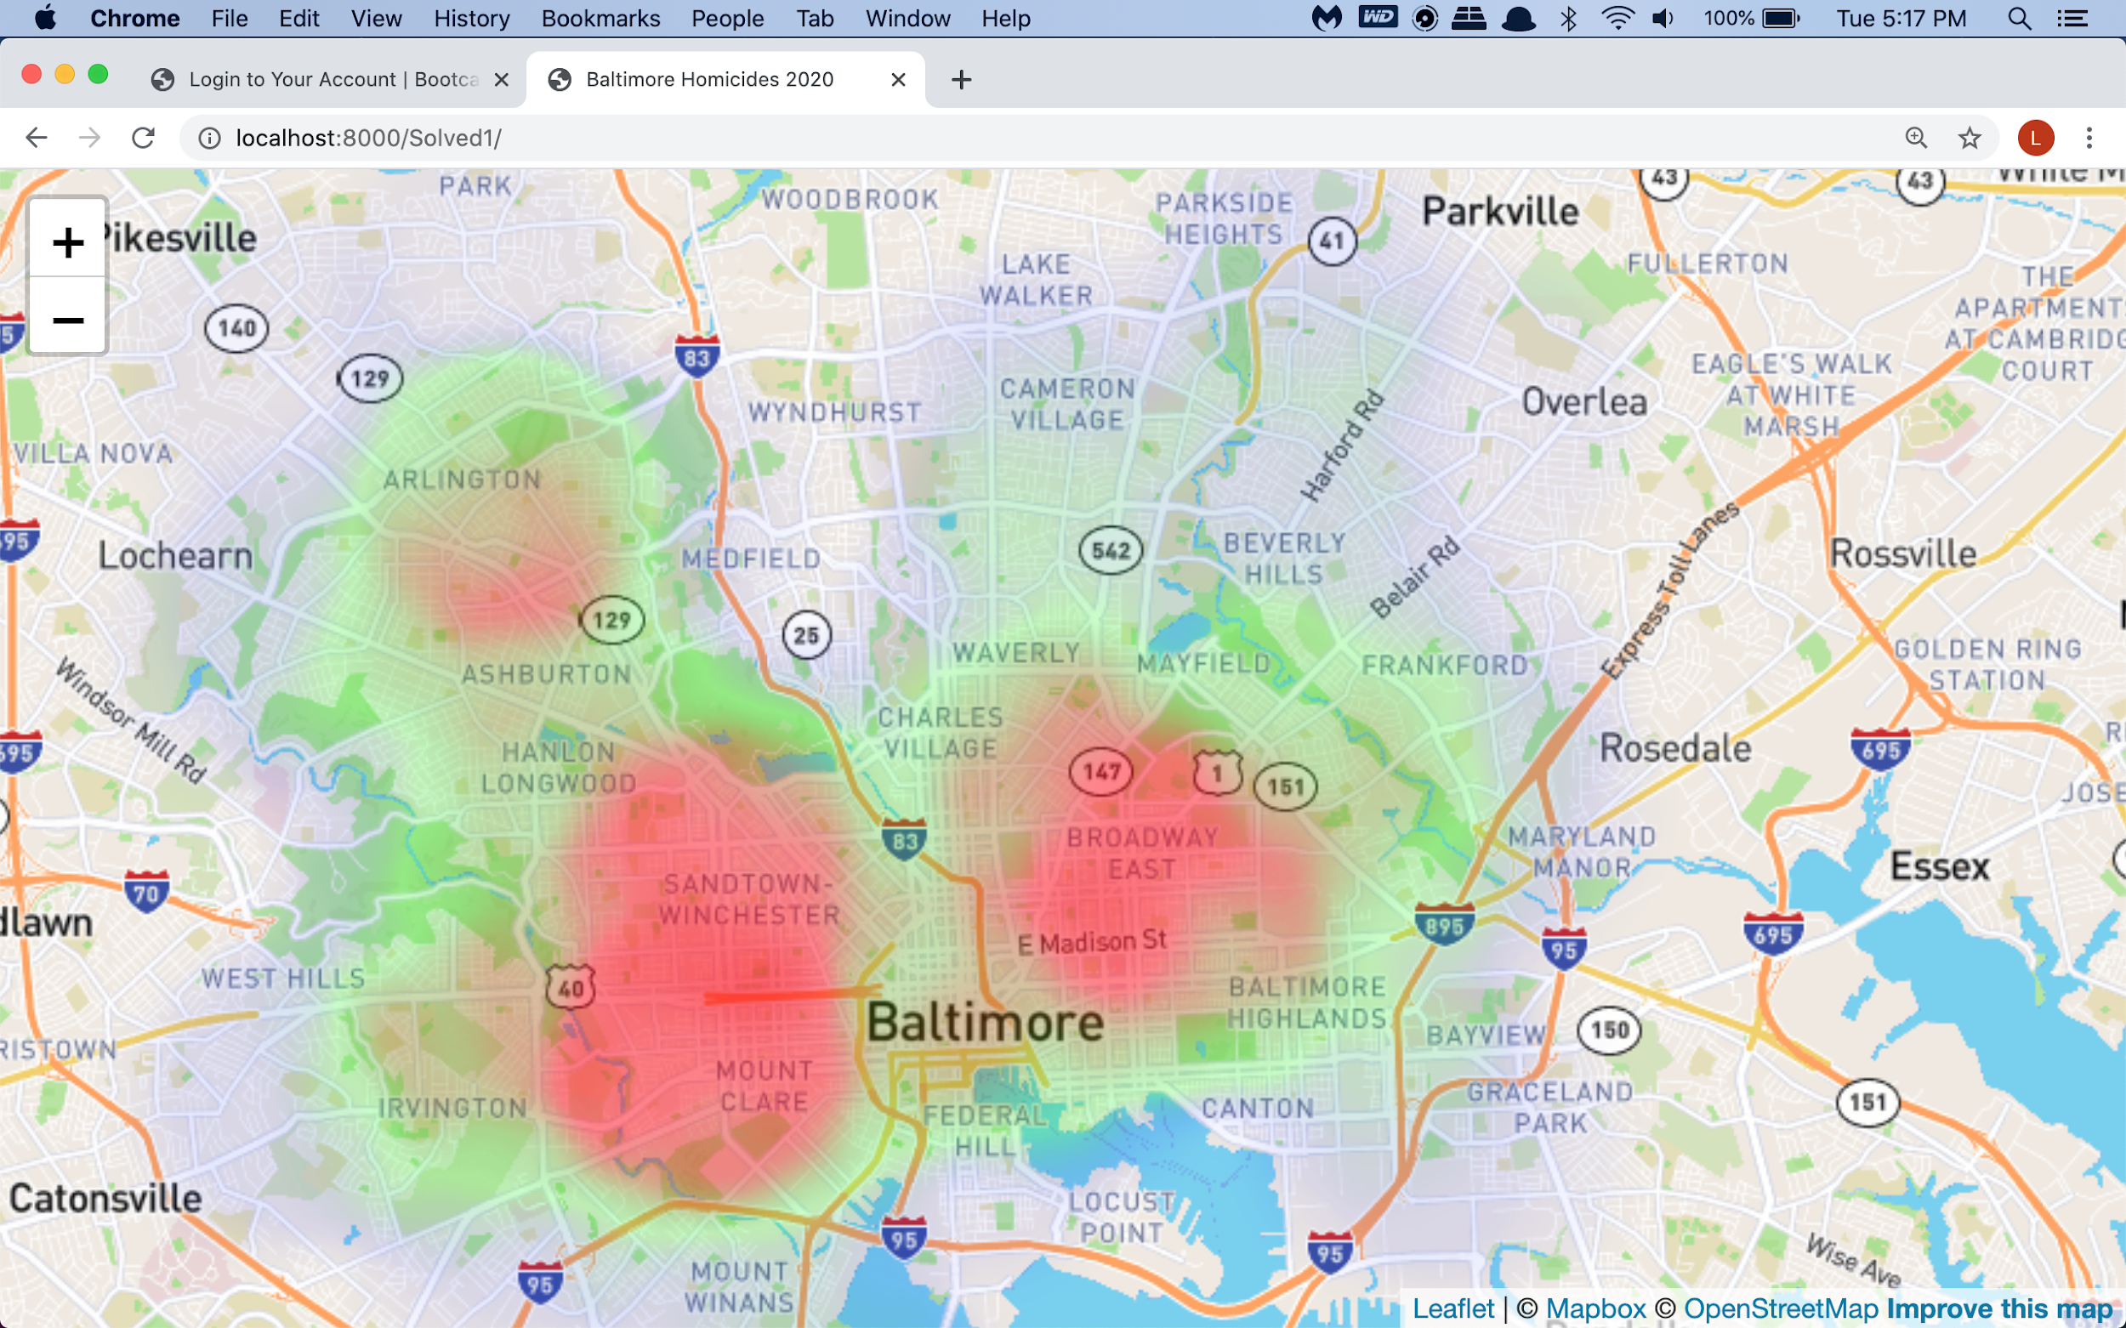
Project 2:
Crimes in Baltimore
Amy Sylla and Laura Michael

Slide 2
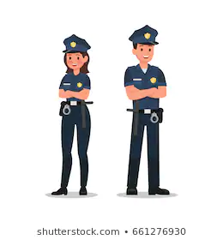
Theme: Crimes in Baltimore
Important part of Maryland
See areas that need more safety
See areas that need more crimes prevention techniques

Slide 3

Step 1:
Find a good database
Open Baltimore
Gov site
Easy to access
Provides different data formats (Json, CSV…)
Very detailed and complete

Slide 4
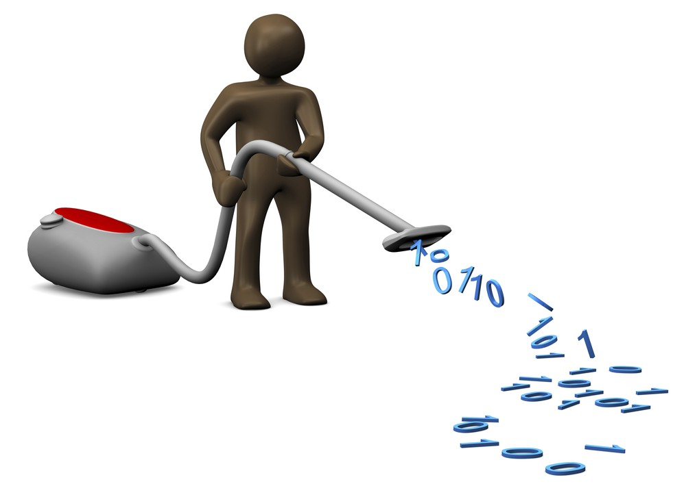
Step 2: ETL
Load our in data jupyter notebook
Get only the information we needed (columns,. homicides..)
Cleaning using pandas
Transfer in sql using sq
achelmy
Get back our data in a new, fresh CSV file

Slide 5
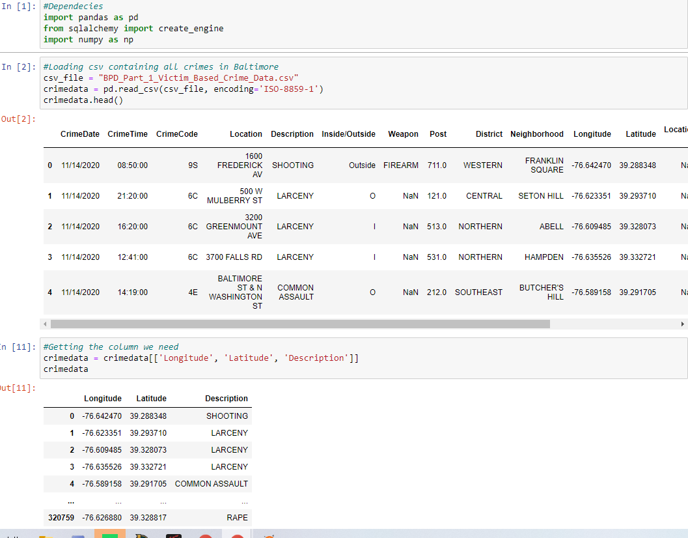

Slide 6
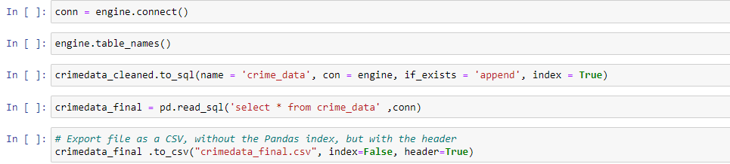
Wireframes

Slide 7

Step 3: Visualization
Use of Leaflet
Markers/Heatmap
Different Layers
Markers/Heatmap

Slide 8
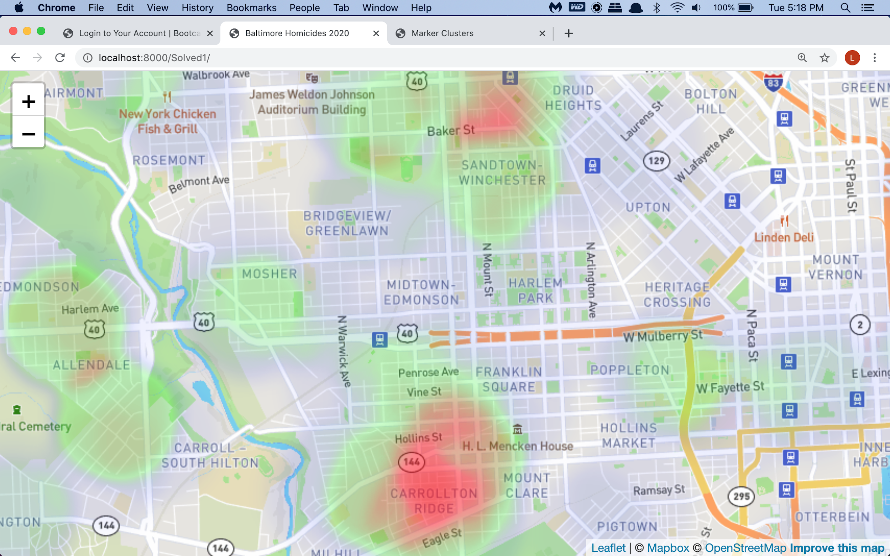
Wireframes

Slide 9
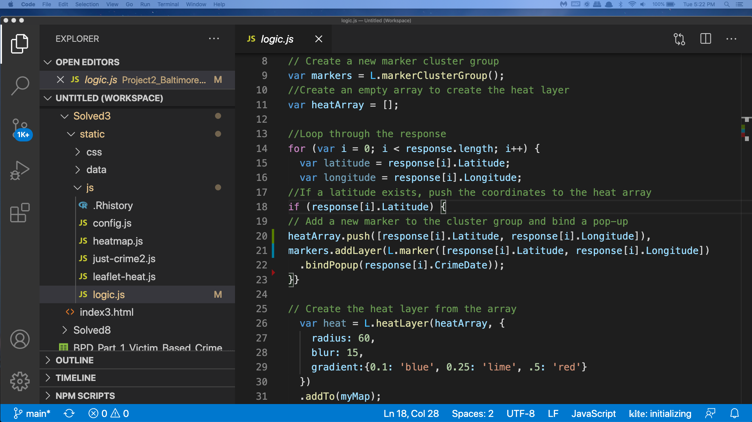
Wireframes

Slide 10
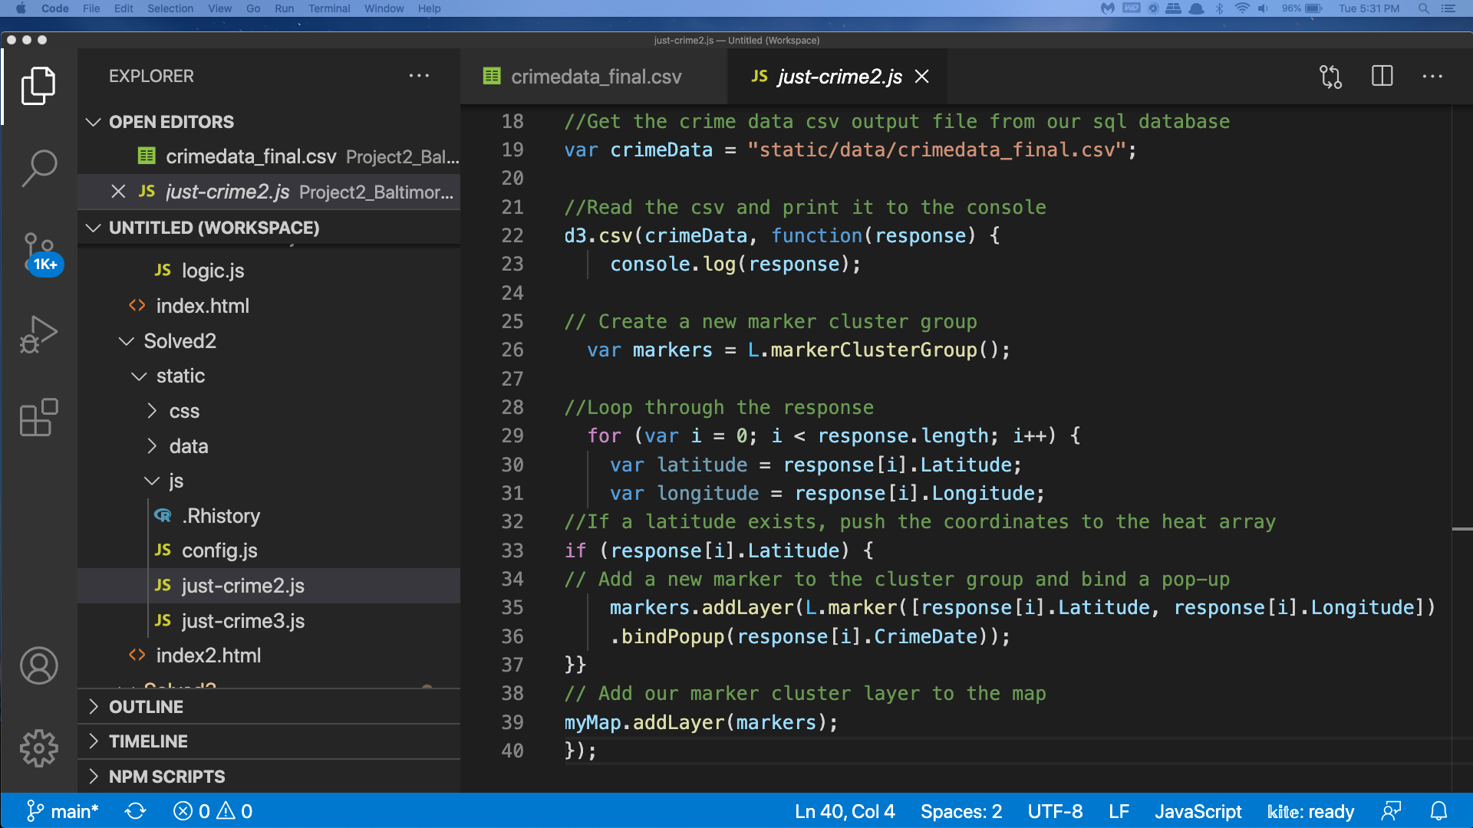

Slide 11
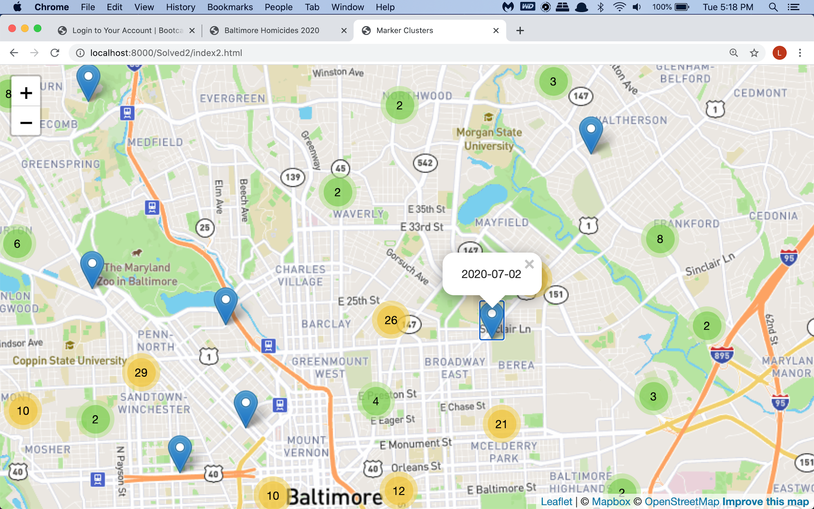

Slide 12
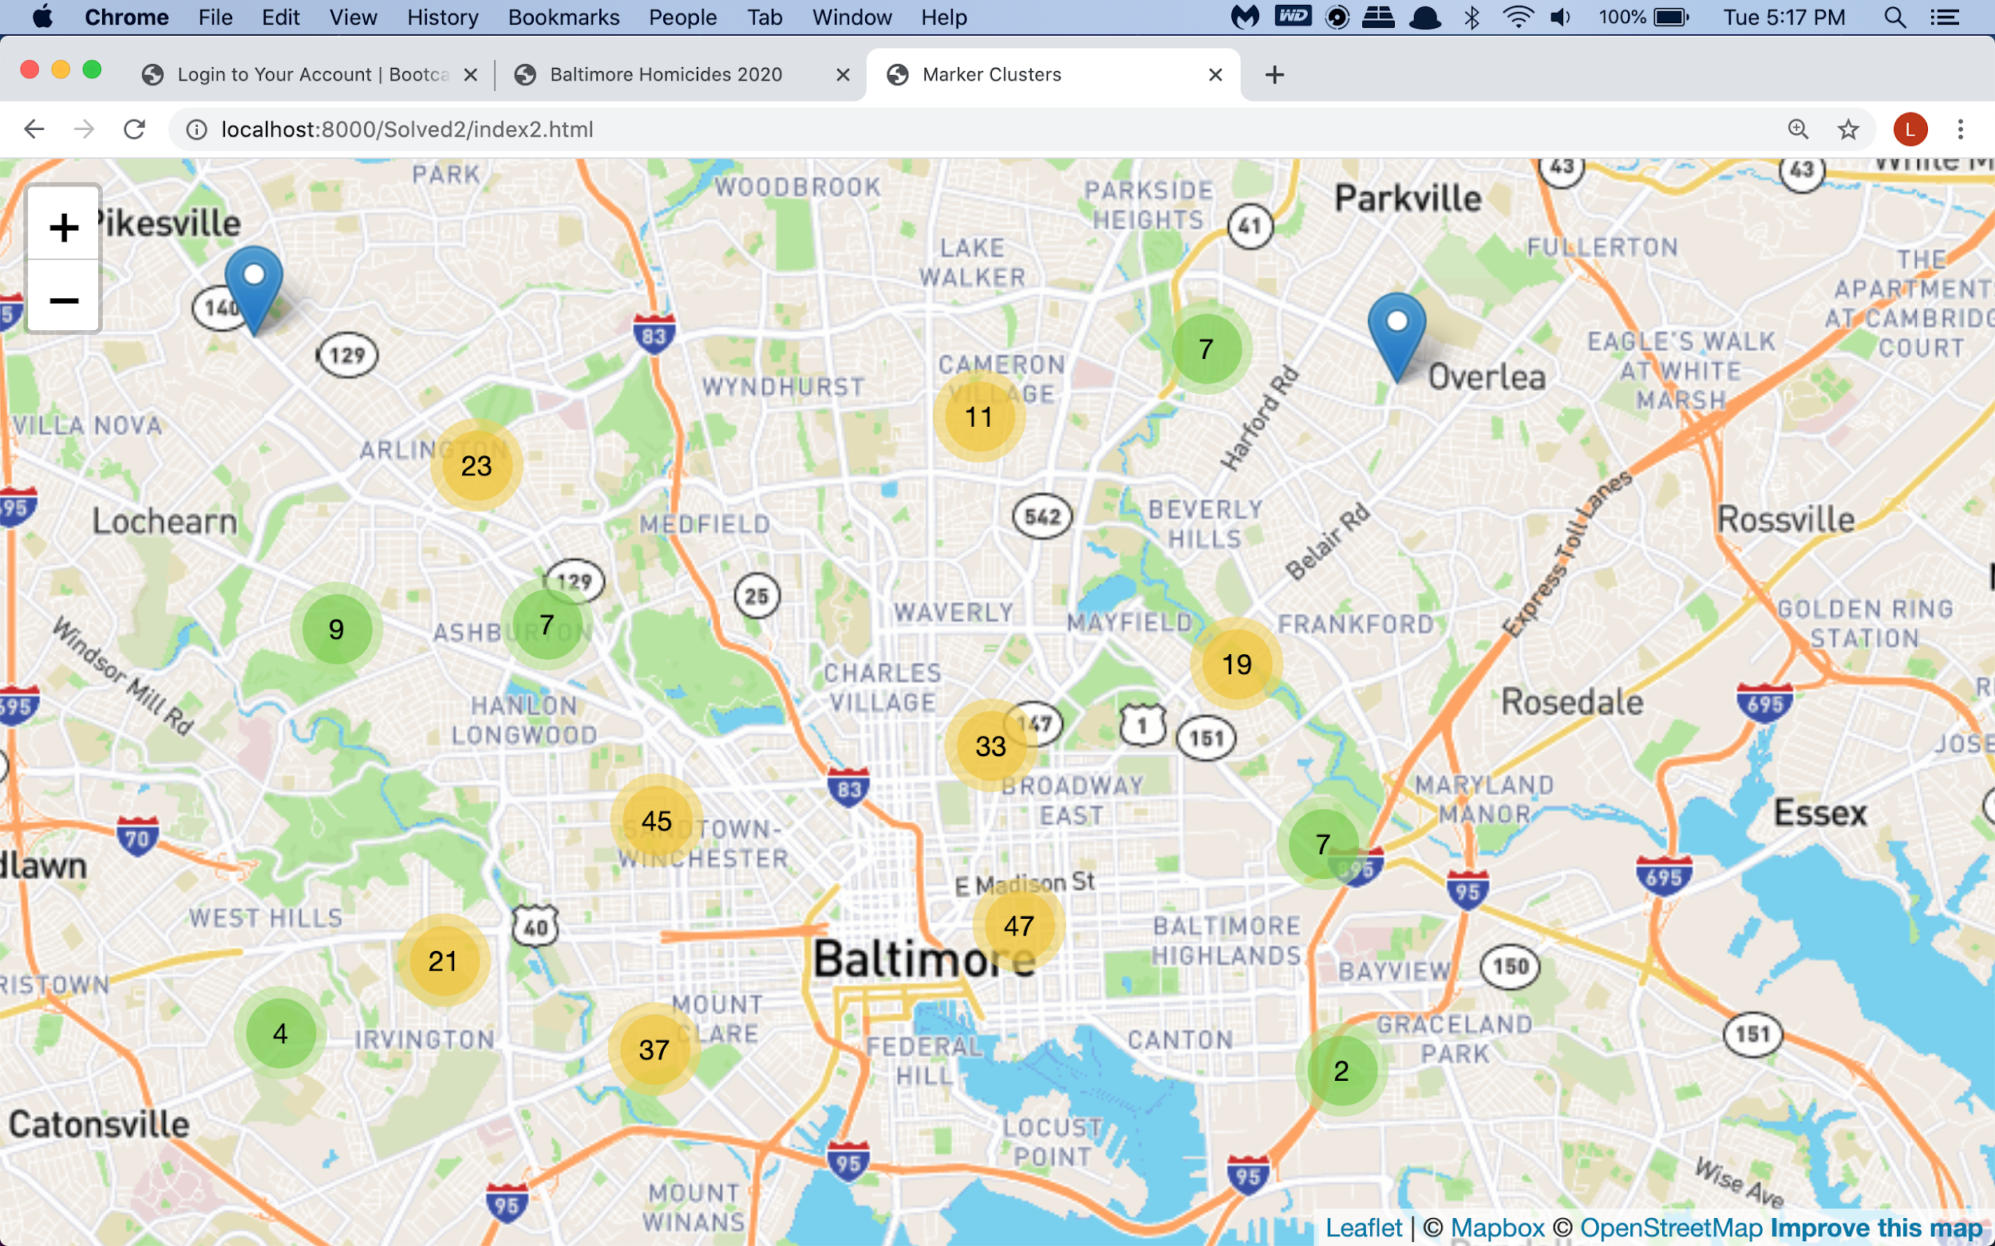

Slide 13

Problems encountered
Complete change of theme due to databases/code problems
Couldn't get to show different layers of the same webpage

Slide 14
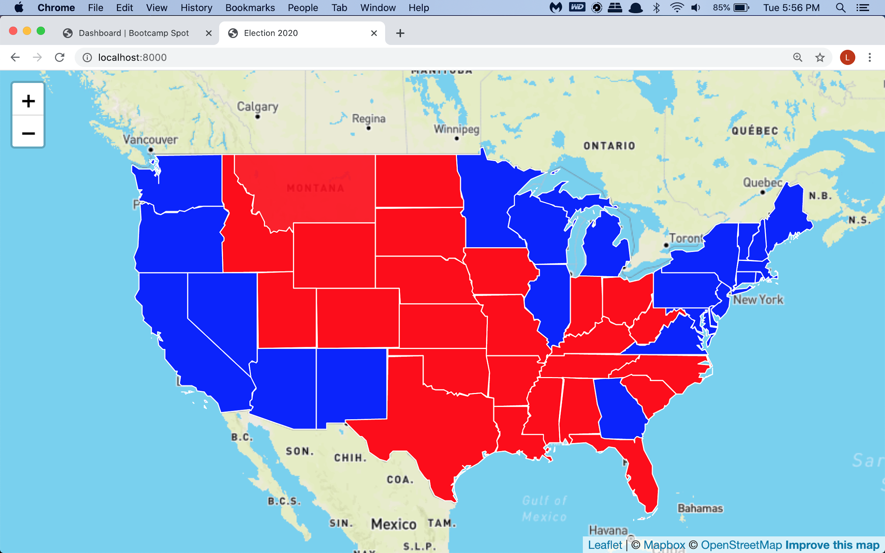

Slide 15
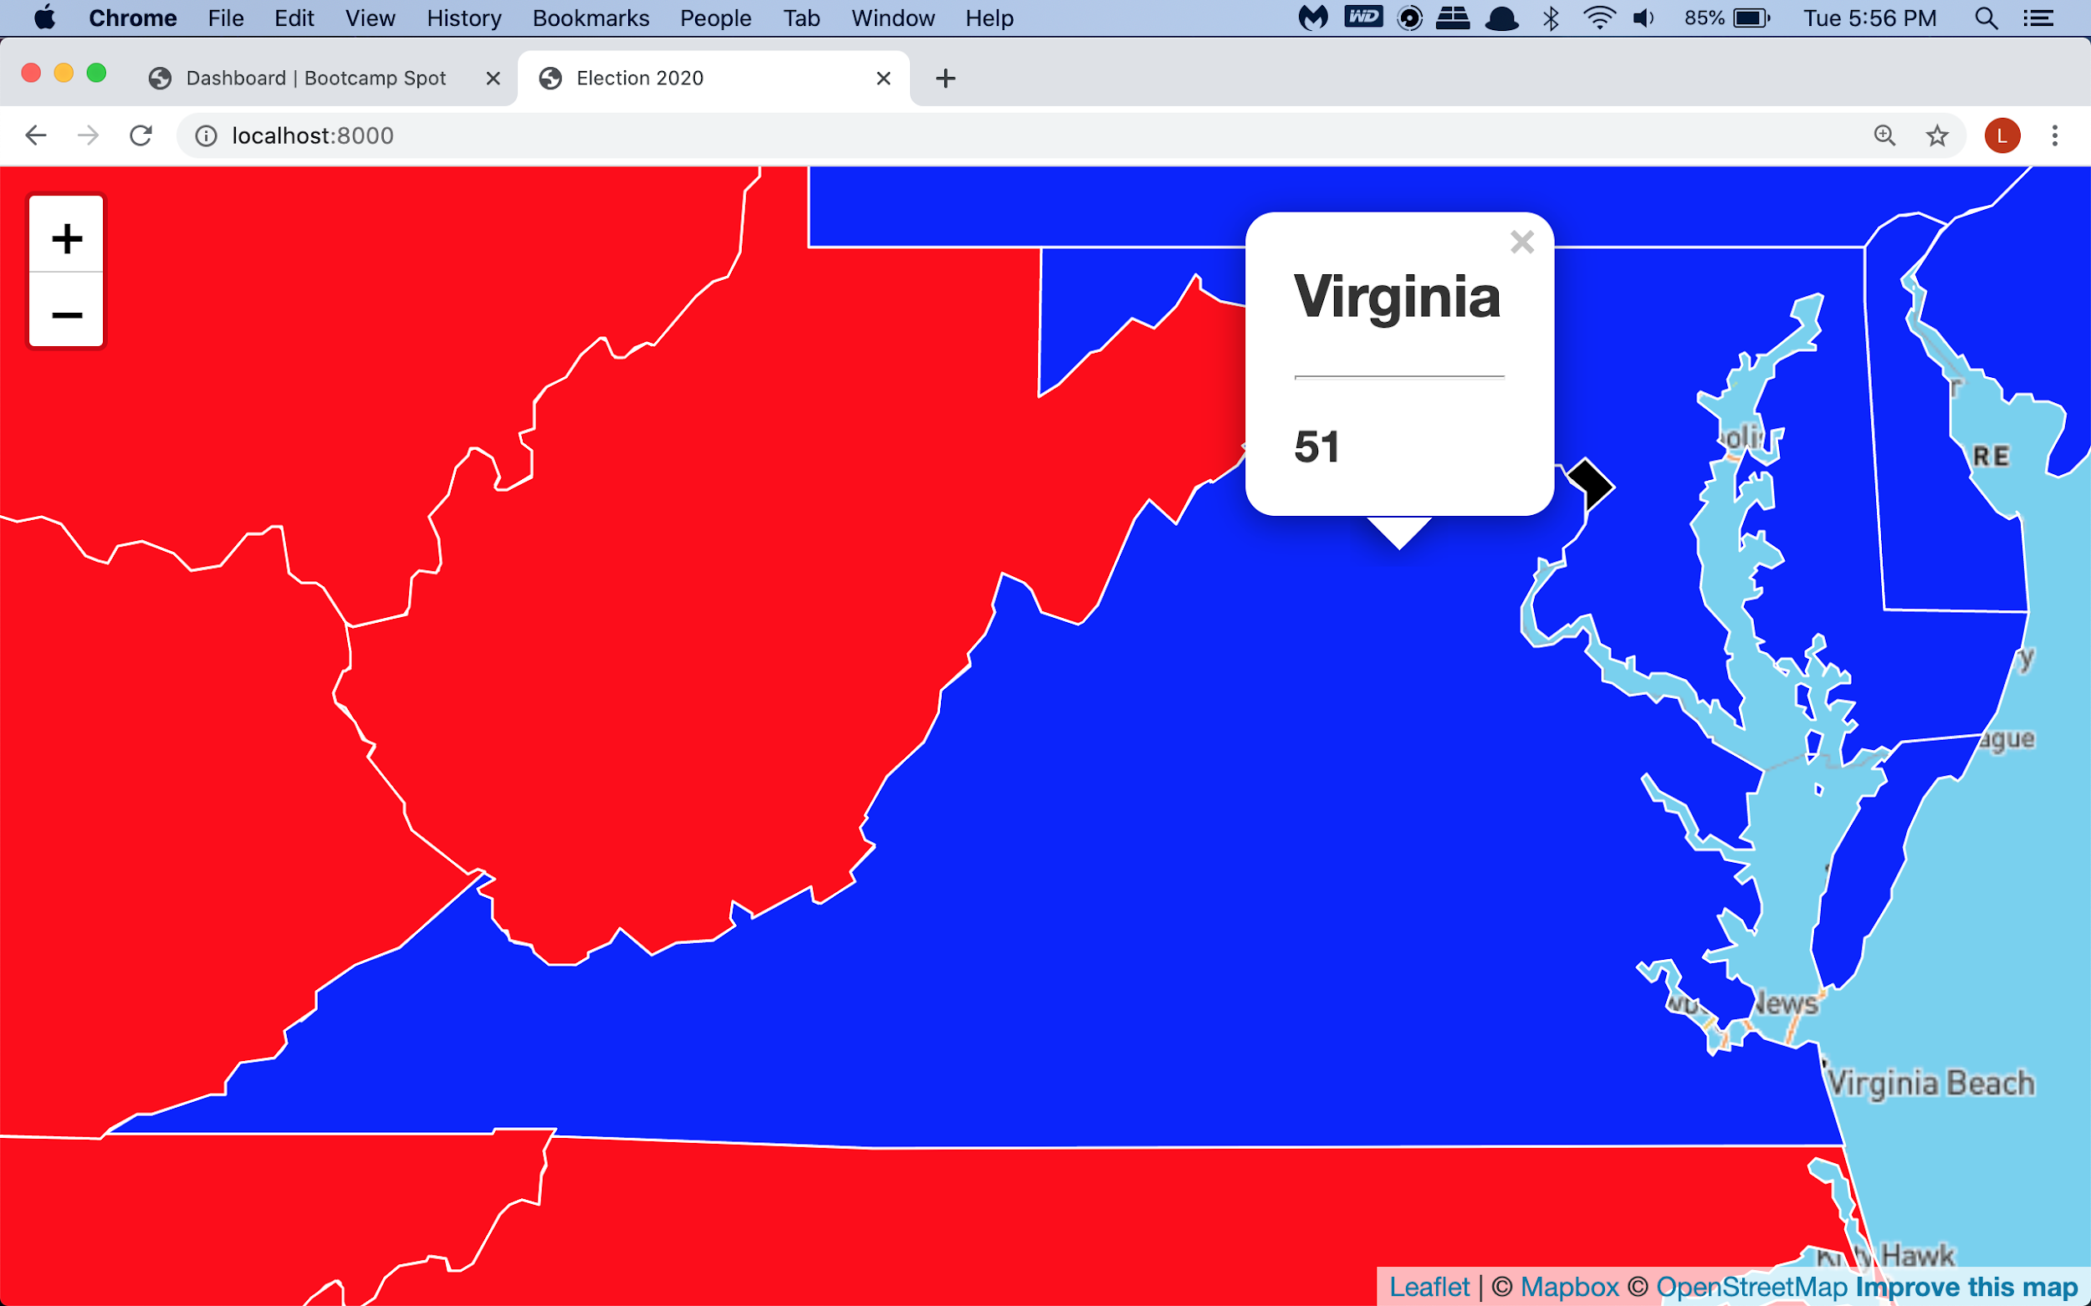

Slide 16
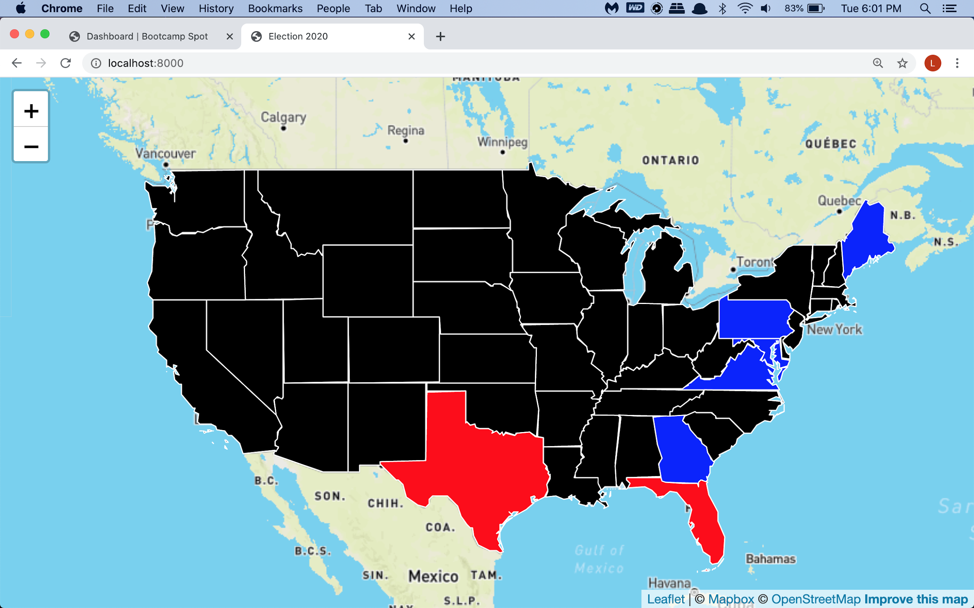

Slide 17

What to improve next time
Better ETL
Time management
More research

Slide 18
Questions ?

Slide 19

Thank you for listening !

